Slide 1
Maths
Unit 6 – Fractions and Percentages.
WALT:
6Nf.02: Understand that proper and improper fractions can act as operators.

Slide 2



WALT: Understand that proper and improper fractions can act as operators.
I can define the terms proper fraction, improper fraction and operator.
I can use a fraction as an operator to find amounts.
I can use a fraction as an operator to compare amounts.

Slide 3
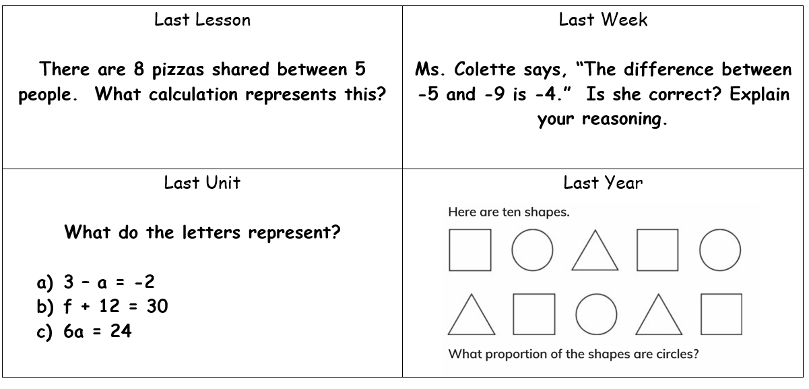
Retrieval Practice
WALT: Understand that proper and improper fractions can act as operators.

Slide 4
Starter – Define these terms to your partner:
WALT: Understand that proper and improper fractions can act as operators.
A fraction in which the numerator (top number) is greater than the denominator (bottom number.)
Proper fraction
Improper fraction
Operator
A fraction in which the denominator (bottom number) is greater than the numerator (top number.)
A command that tells you what to do with the numbers. E.g. + - x ÷

Slide 5
Think about what we learned last lesson.
WALT: Understand that proper and improper fractions can act as operators.
What operator does a fraction act as?
÷

Slide 6
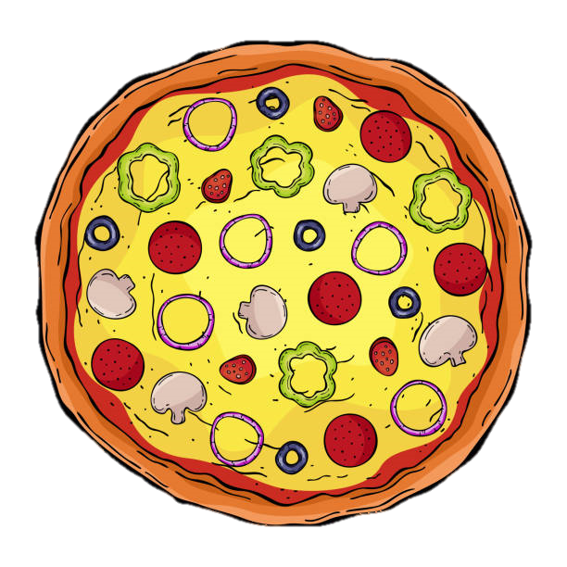
If Mr. Jon eats ½ of a pizza that’s one pizza divided into two equal parts.
WALT: Understand that proper and improper fractions can act as operators.
One pizza
½
Divided
Into two equal parts

Slide 7

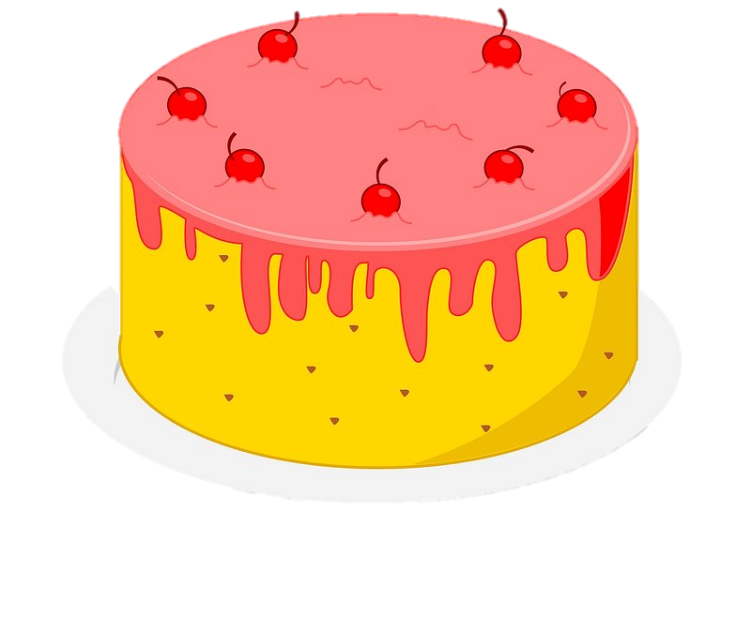
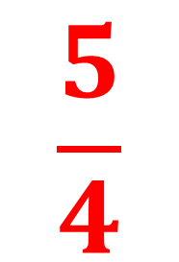
We can also use improper fractions as operators.
WALT: Understand that proper and improper fractions can act as operators.
If I have 5 cakes divided by 4 people how much cake does each person get?
$$\frac{5}{4}$$

Slide 8
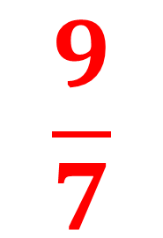
We can also use improper fractions as operators.
WALT: Understand that proper and improper fractions can act as operators.
If 7 people share 9 cakes, how much would they get each?
9 ÷ 7 =
$$\frac{9}{7}$$

Slide 9
We can use fractions as operators to find amounts.
WALT: Understand that proper and improper fractions can act as operators.
What is ¾ of 12?
First we divide by the denominator.
12 ÷ 4 = 3
Then we multiply by the numerator.
3 x 3 = 9

Slide 10
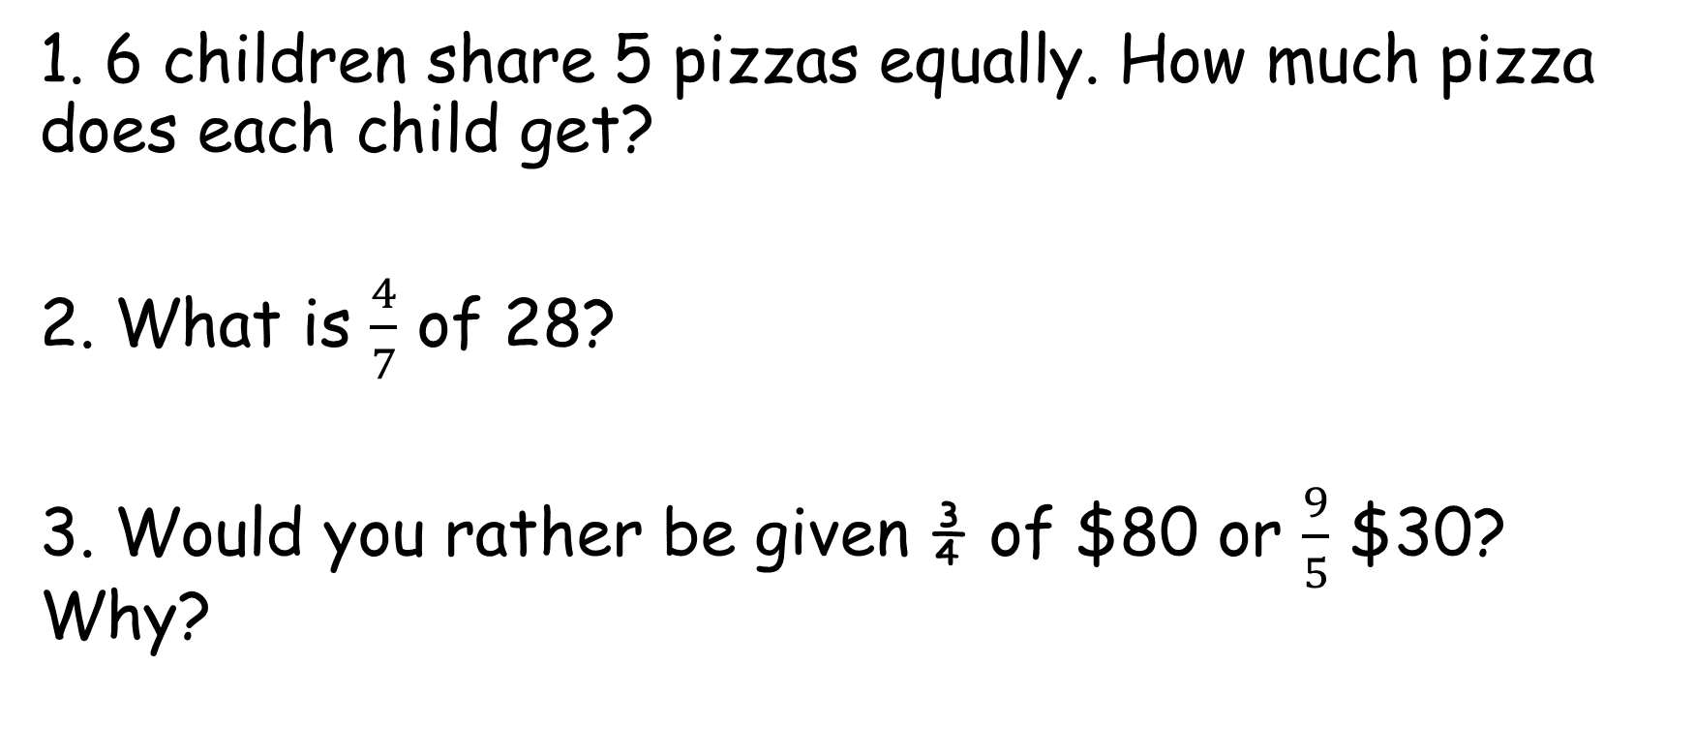
Check your understanding
WALT: Understand that proper and improper fractions can act as operators.
1. 6 children share 5 pizzas equally. How much pizza does each child get?
2. What is $\frac{4}{7}$ of 28?
3. Would you rather be given ¾ of $80 or $\frac{9}{5}$ $30? Why?

Slide 11
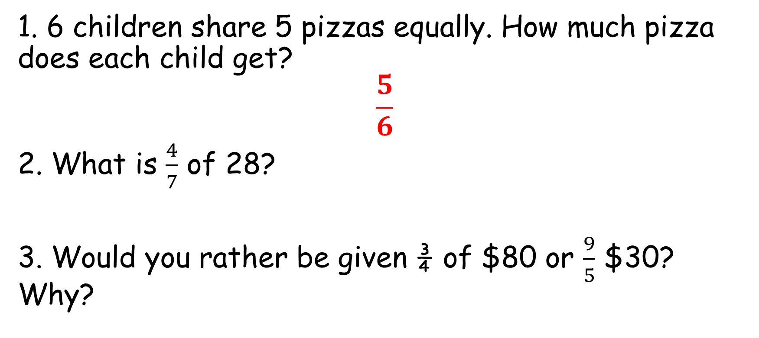
Check your understanding
WALT: Understand that proper and improper fractions can act as operators.
1. 6 children share 5 pizzas equally. How much pizza does each child get?
$$\frac{5}{6}$$
2. What is $\frac{4}{7}$ of 28?
3. Would you rather be given ¾ of $80 or $\frac{9}{5}$ $30? Why?
16
¾ of $80 = $60 $\frac{9}{5}$ of $30 = $54

Slide 12
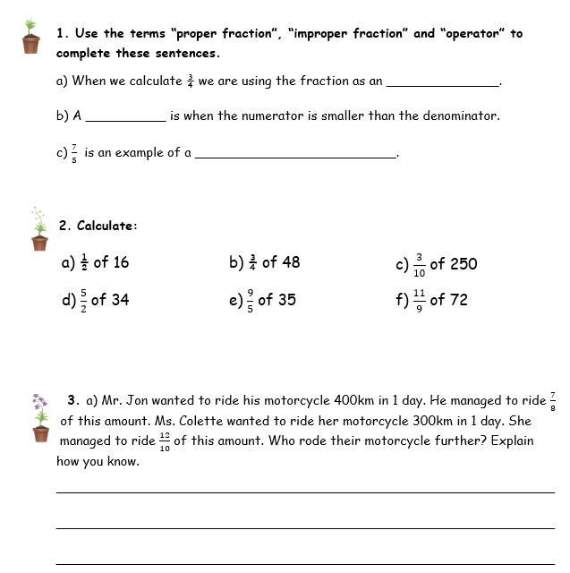
WALT: Understand that proper and improper fractions can act as operators.

Slide 13
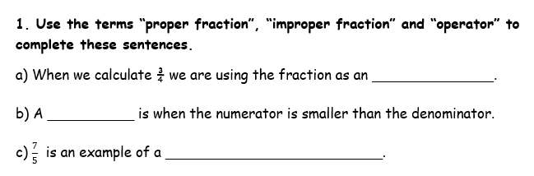
WALT: Understand that proper and improper fractions can act as operators.
operator
proper fraction
improper fraction

Slide 14
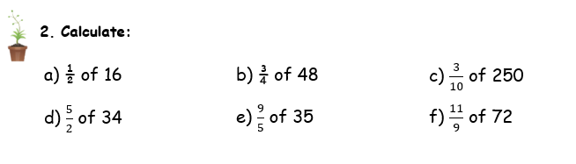
WALT: Understand that proper and improper fractions can act as operators.
8
36
75
85
63
88

Slide 15
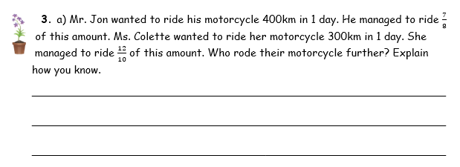
WALT: Understand that proper and improper fractions can act as operators.
Ms. Colette. 400km divided by 8 is 50km. 50km multiplied by 7 is 350km so Mr. Jon rode 350km. 300km divided by 10 is 30km. 30km multiplied by 12 is 360km so Ms. Colette rode 360km. 360km > 350km so Ms. Colette rode further.

Slide 16
WALT: Understand that proper and improper fractions can act as operators.
I can define the terms proper fraction, improper fraction and operator.
I can use a fraction as an operator to find amounts.
I can use a fraction as an operator to compare amounts.

